Slide 1

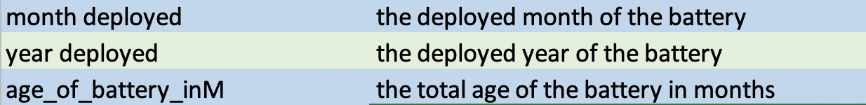
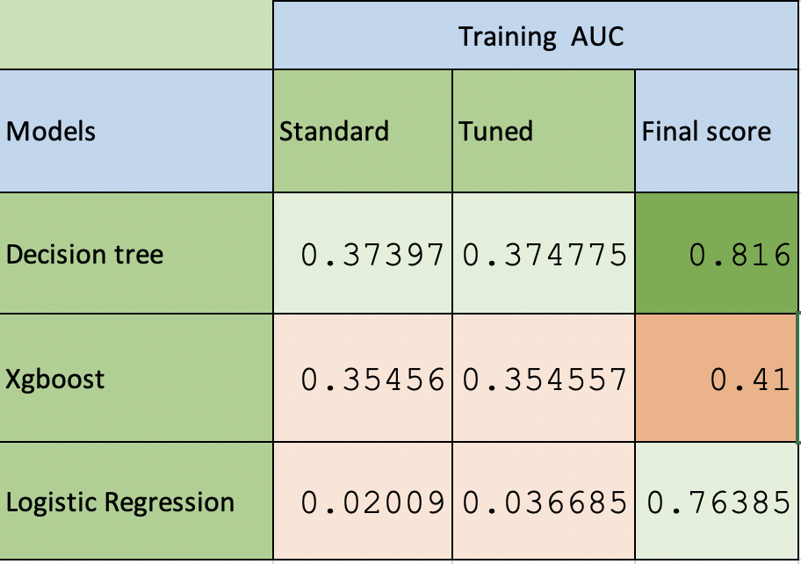
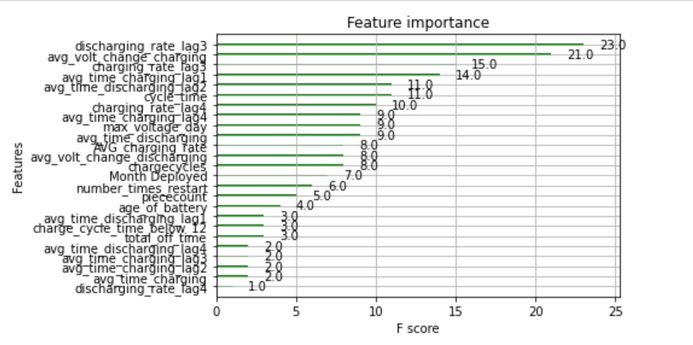
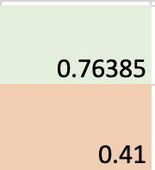
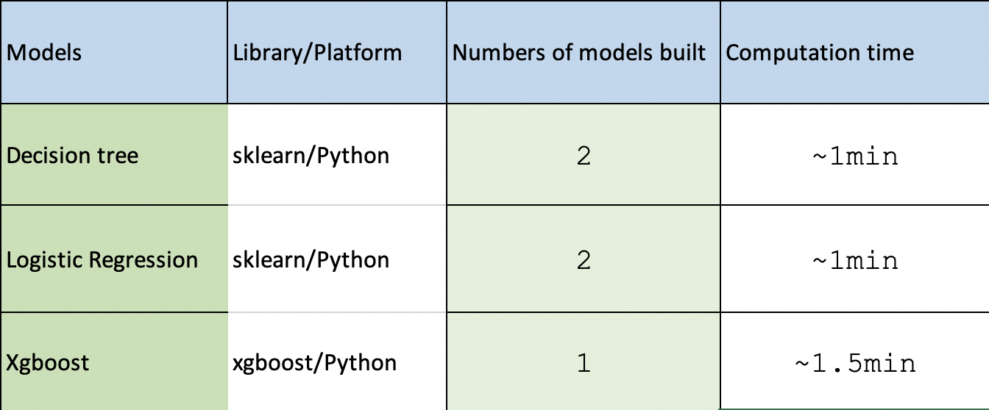
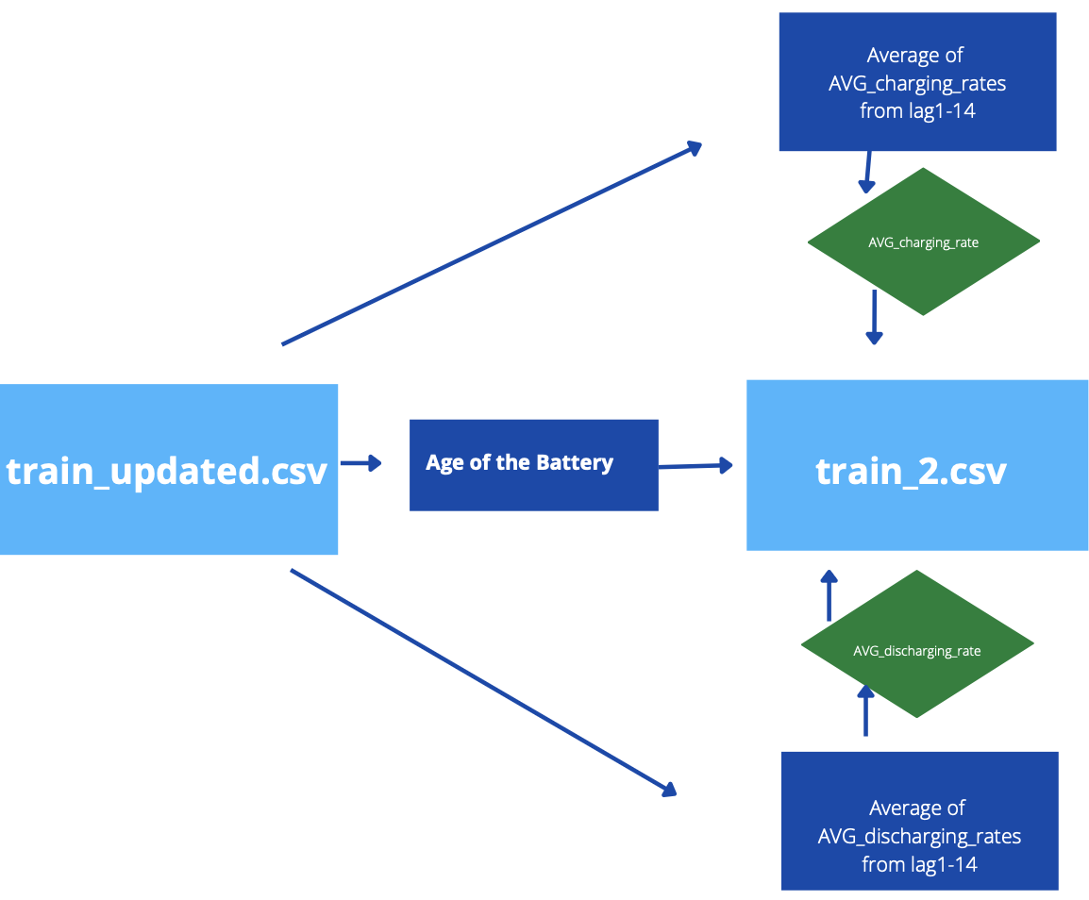
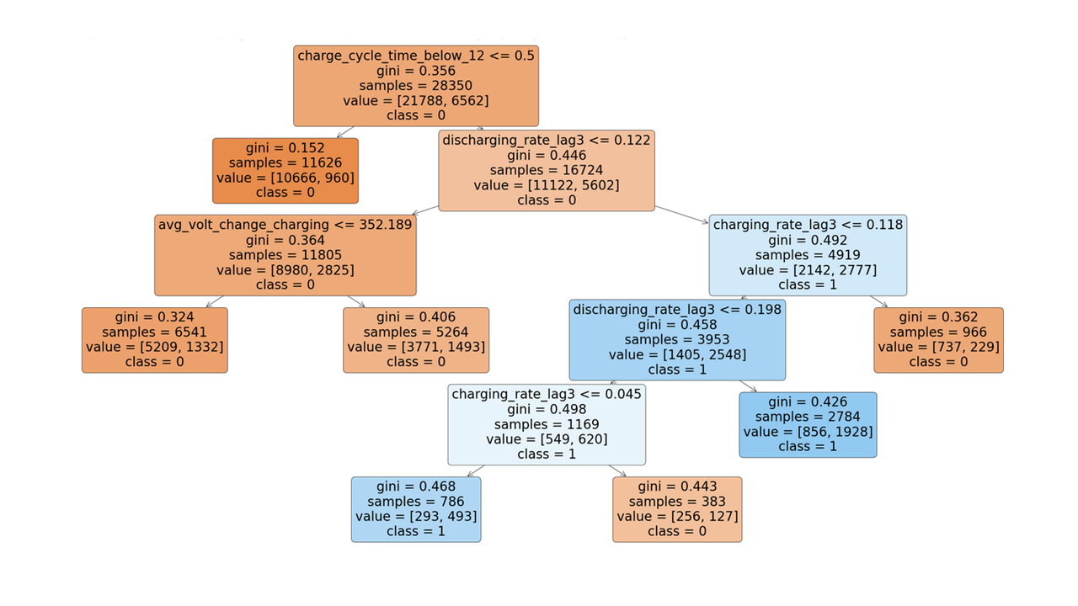
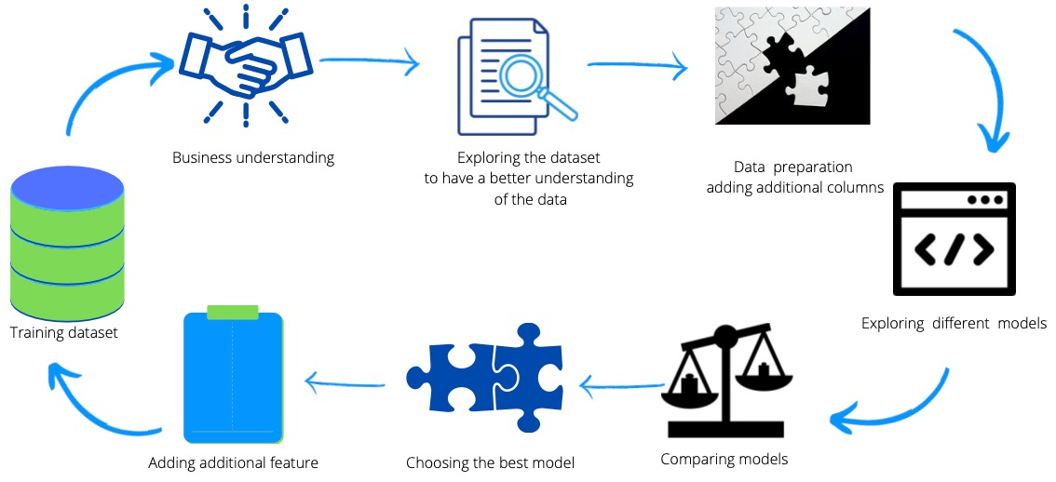
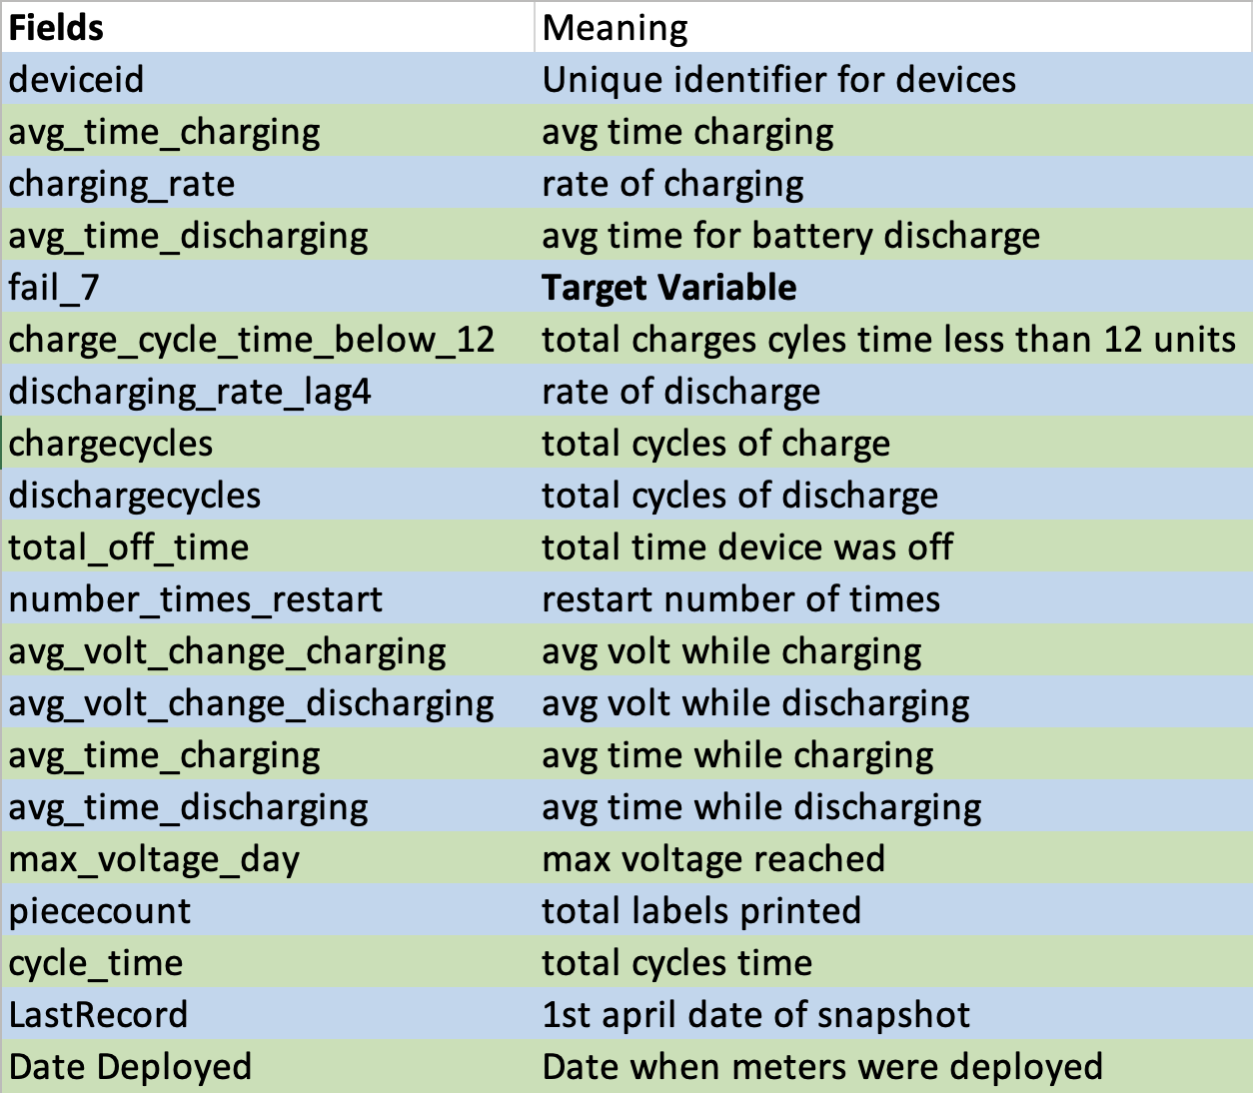
Predicting the meters that will fail within the next seven days
By: Zi Zeng, Natalia Kurbakova, Khilola Rustamova
Abstract
Model and Results
Companies use mailing meters to decrease costs of operating a business and increase the pace of their operations. Pitney Bowes mailing meters play a big part in providing small-scale companies the opportunity to grow at low additional investments as well as assisting organizations of a larger scale with maintaining their customers’ satisfaction from fast service.
The meters are leased hardware, it is important to ensure that the risk of downtime is mitigated and to provide time-sensitive guidelines/help to businesses on how to maintain the meter better if the device is being flagged as at risk. With enough meters running history, it is possible to identify which meters will fail in the next seven days.
Pitney Bowes train data asks participants to help identify when there is an issue with the meter before it fails with the help of two weeks worth of data from 40,500 meters. For this project we worked with multiple libraries such as Sklearn, NumPy, pandas, matplotlib, and seaborn to create a predictive model
Introduction
Pitney Bowes challenge asks the participants to create a model based on the train_updated.csv dataset. Then test the model on the test.csv dataset provided, and report back to the challengers with dataset of the machines that will fail based on the model.
train_updatd.csv → contains machine failure status, voltage usage, off time of the machines, cycle time, mailing piece count , charging, discharging behavior information about 40,500 machines from last fourteen days. → 55 Columns, and 40,500 rows, 16.1 MB
train_2.csv → contains all non-lag columns minus Last Record, with month and year extracted from date deployed. Has new columns AVG_charging_rate & AVG_discharging_rate which is the mean of all 14 dis/charging rates. Added age of battery in months.→40,500 rows, 30 columns
test_for_submissions.csv → Contains the same information as the test_updated.csv of new machines except the status of failure. → 54 columns, and 49,990 rows.
Full_Version2_Test.ipynb → A Jupyter notebook containing explanatory and decision tree model codes written in python.
Methodology
Data
Modeling Process
The dataset is provided by Pitney Bowes, and below are the meaning of the fields in the dataset.
To get a clearer understanding of the mailing meters, new columns were added such as the age of the battery, month and and year deployed to find the decaying period of the machines. The AVG_charging_rate & AVG_discharging_rate which is the mean of all 14 dis/charging rates All the columns made up totaling into 60 columns.
Conclusion
The significant fields were the Boolean predictor, the charging and discharging rate gathered three days prior to April 1st 2021, as well as the average voltage change when charging and discharging.
Even though the model rated a lot of devices that didn’t fail yet as already failed, this only highlights the proactive nature of utilizing different methods to solve the business problem, and those devices might actually need to be taken better care of during its us

